Slide 1


Hadoop and Map-Reduce Programming
Associate Professor
Department of Computer Science and Engineering

Slide 2
Session Objectives
Hadoop Architecture
Map Reduce Programming
Sample Map-Reduce Functions
Sample Word Count Programme

Slide 3
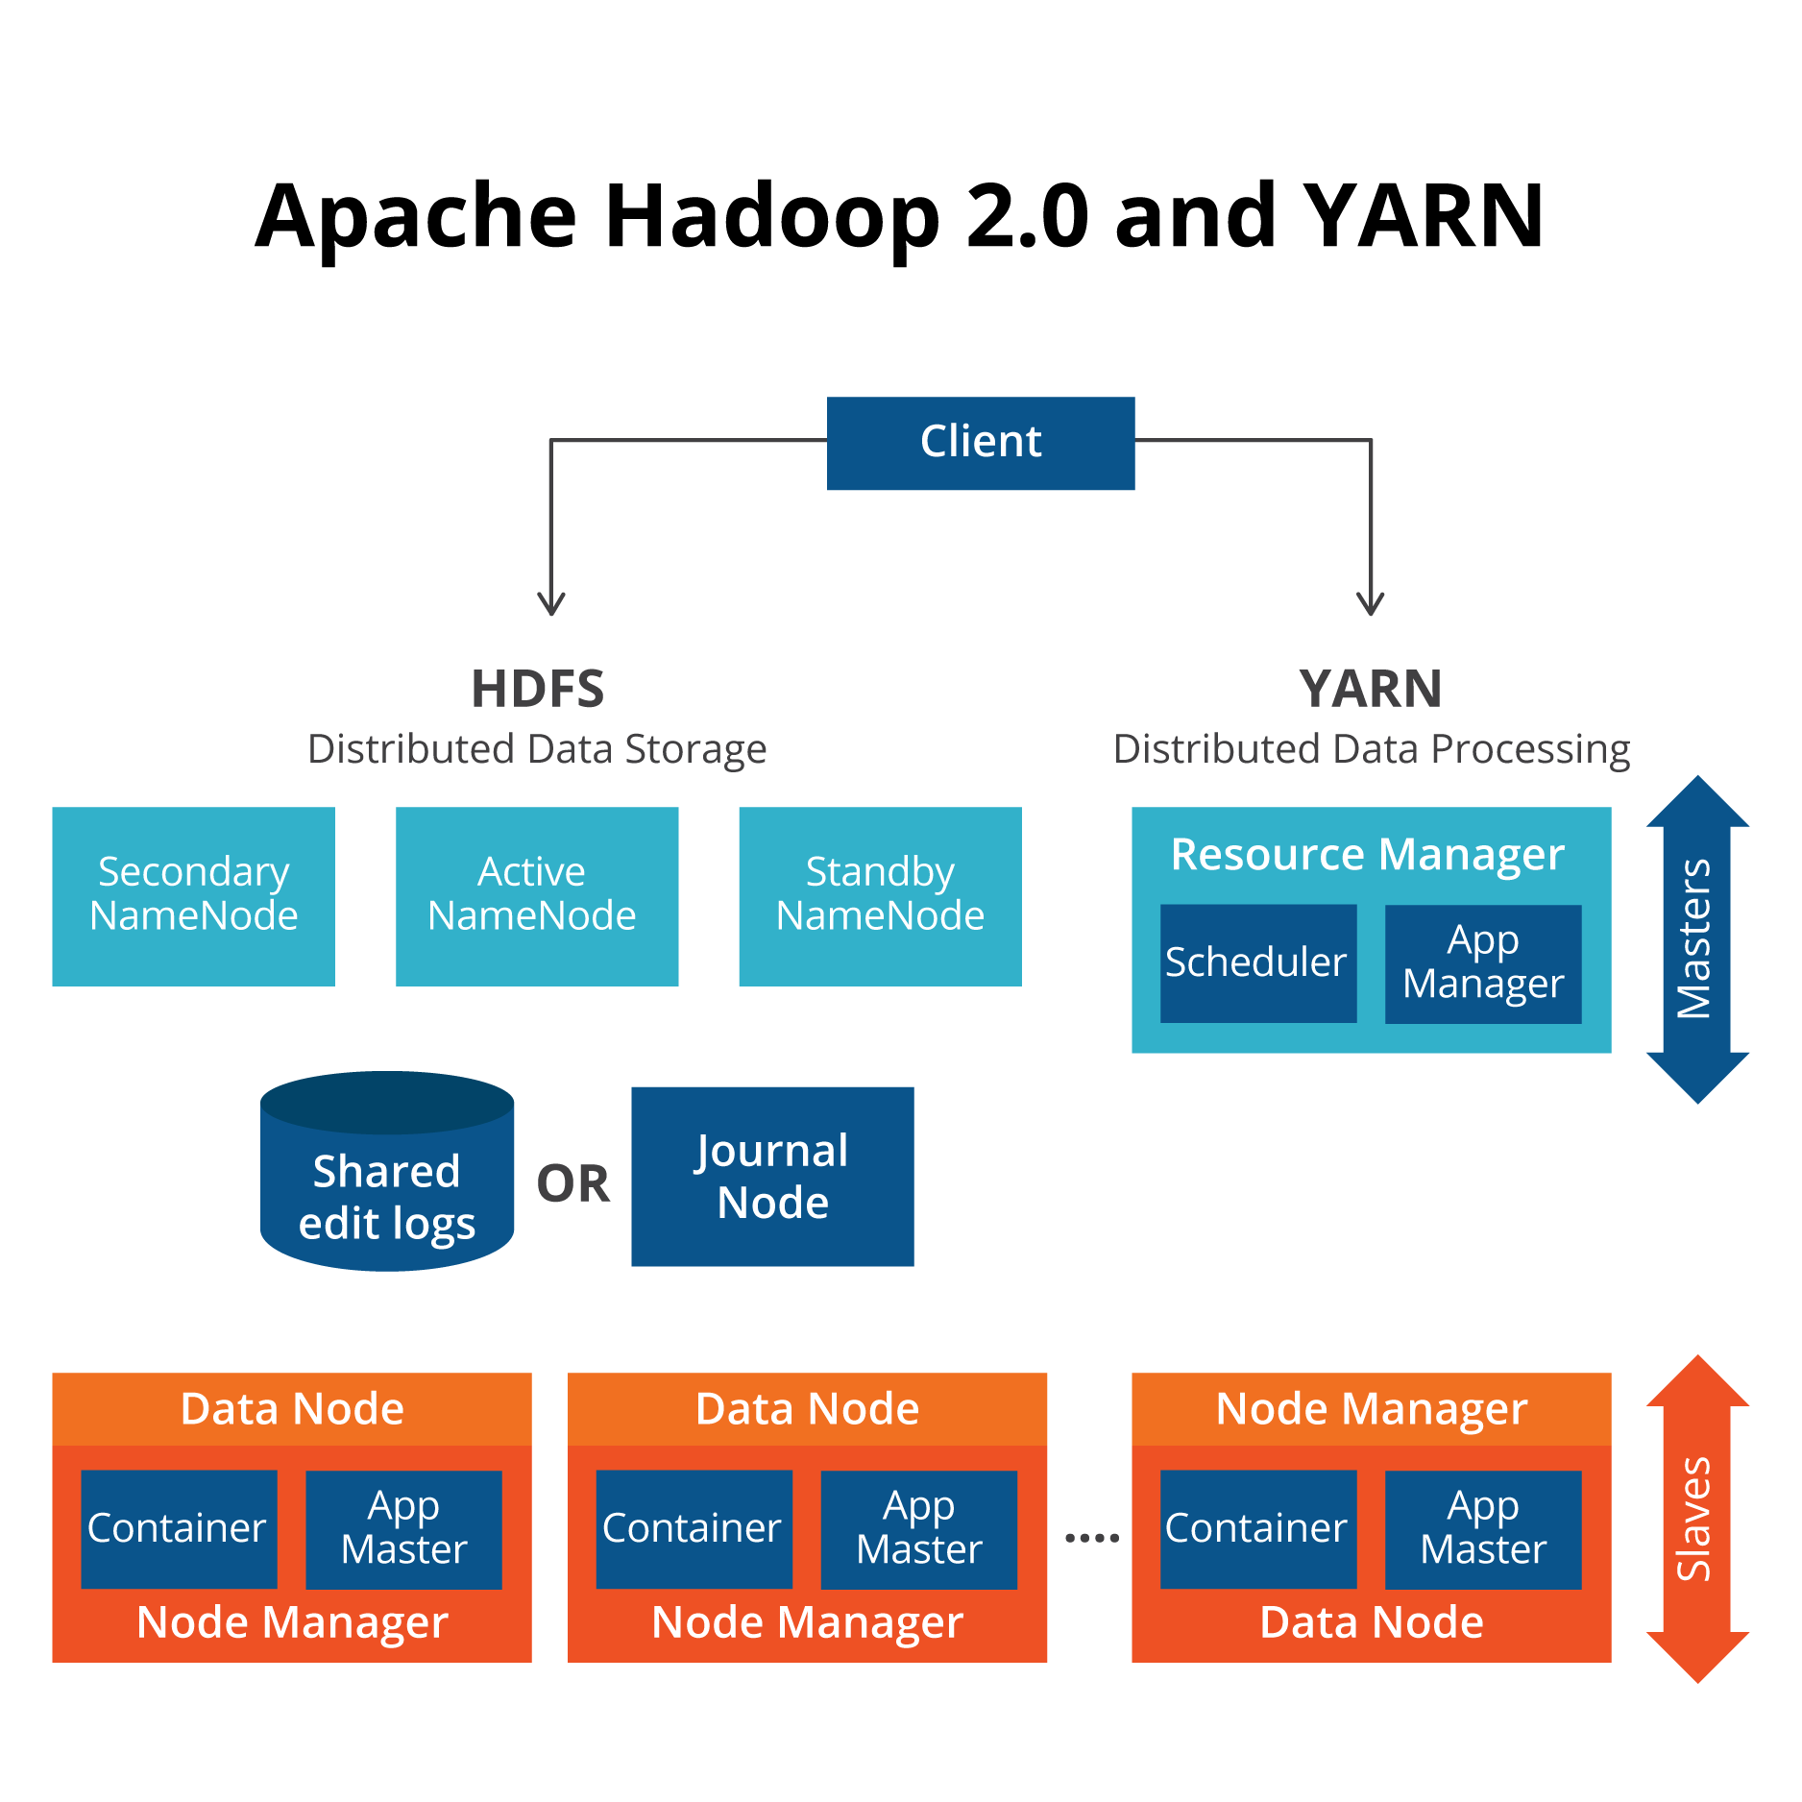
Hadoop Architecture
Notes:
NameNode is the centerpiece of HDFS. NameNode is also known as the Master. NameNode only stores the metadata of HDFS – the directory tree of all files in the file system, and tracks the files across the cluster. NameNode does not store the actual data or the dataset. The data itself is actually stored in the DataNodes.

Slide 4
Hadoop Components
NameNode: controls operation of the data jobs.
DataNode: this writes data in blocks to local storage. And it replicates data blocks to other datanodes. DataNodes are also rack-aware. You would not want to replicate all your data to the same rack of servers as an outage there would cause you to loose all your data.
Secondary NameNode: this one take over if the primary Namenode goes offline.
Job Tracker: sends MapReduce jobs to nodes in the cluster.
Task Tracker: accepts tasks from the Job Tracker.
Contd…

Slide 5
Hadoop Components
Yarn: runs the Yarn components Resource Manager and Node Manager. This is a resource manager that can also run as a stand-alone component to provide other applications the ability to run in a distributed architecture. For example you can use Apache Spark with Yarn. You could also write your own program to use Yarn. But that is complicated.
Client Application: this is whatever program you have written or some other client like Apache Pig. Apache Pig is an easy-to-use shell that takes SQL-like commands and translates them to Java MapReduce programs and runs them on Hadoop.
Application Master: runs shell commands in a container as directed by Yarn.

Slide 6
Hadoop Installation Type
Two types of installation: Single Node and Cluster
Single Node installation is for learning purpose and both data node and name node are on the same machine.
For commercial purpose it is installed in cluster node, meaning data nodes to run on different machines.
The whole set of machines is called the cluster.
A Hadoop cluster can scale immensely to store pentabytes of data.
You can see the status of your cluster here using http://localhost:50070/
The sample screen are shown in next slide.

Slide 7
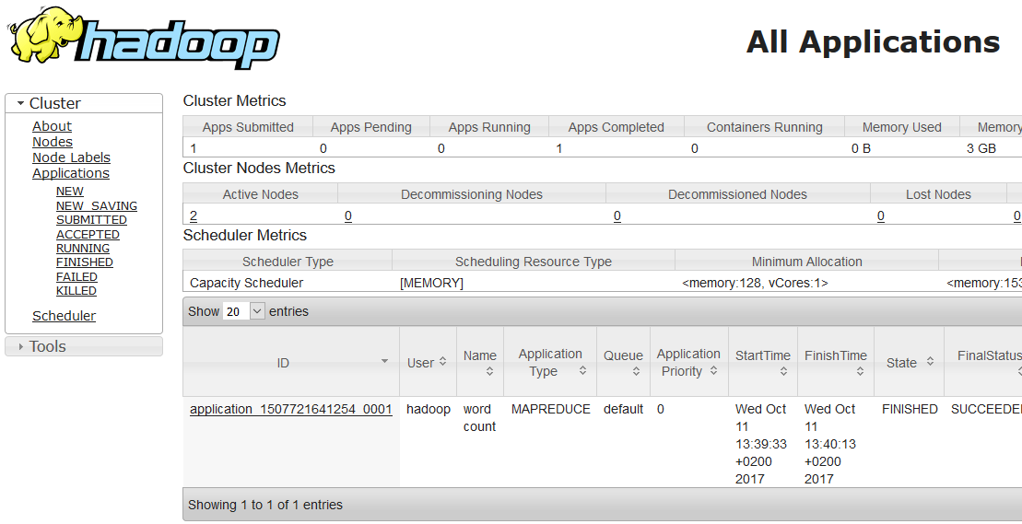
Cluster Information - 1

Slide 8
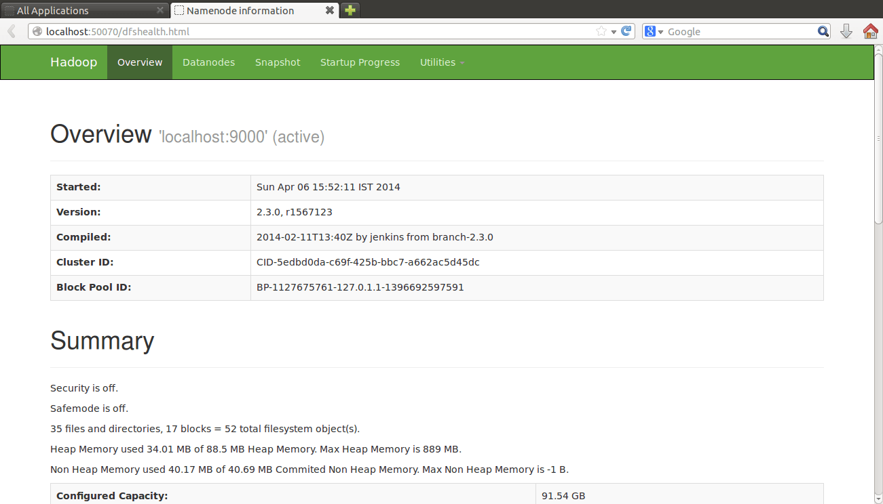
Cluster Information - 2

Slide 9
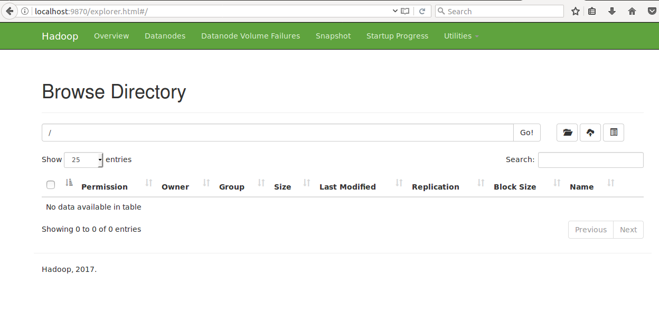
Cluster Information - 3
Notes:
Data Block size is : 128MB or 256MB

Slide 10
Map Reduce Programming
Map-Reduce framework is combination of two functions: Mapper and Reducer.
It handles a job that reads the text from a set of text files distributed across a cluster's nodes via the distributed file system.
A "mapper" process converts the input to a set of <key, value> pairs.
A "shuffle/sorter" process sorts these pairs by their key values.
A "reducer" process then combines these sorted pairs in a way that solves a problem, and typically produces a different set of <key, value> pairs, which is the output of the job.
Contd…..

Slide 11
Map Reduce Programming
The basic steps of a job in Map-Reduce are thus:
(input) : Some text data from files
(process) splitting -> <k1, v1> mapping -> <k2, v2> shuffling/sorting -> <k2, v2> reducing -> <k3, v3>
(output): Unique data words

Slide 12
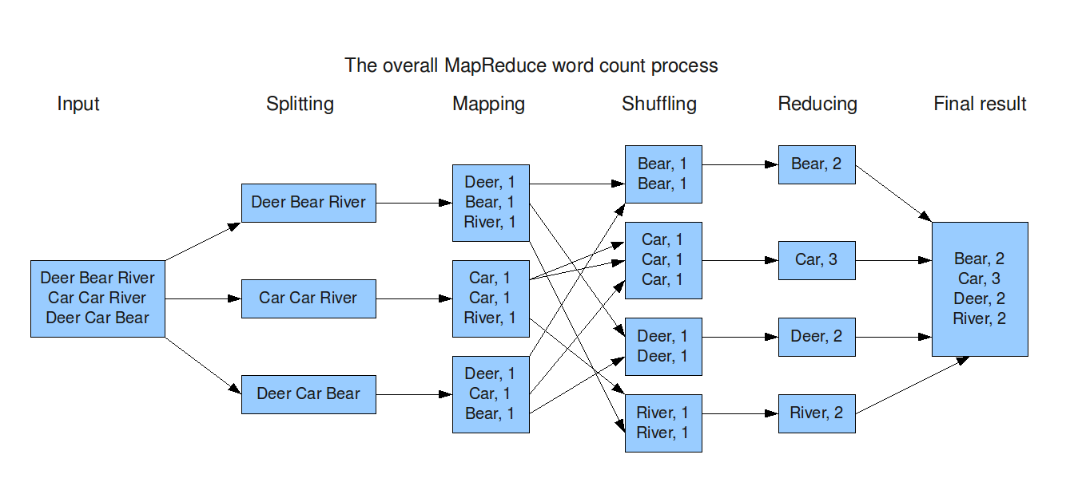
Example of Map Reduce

Slide 13
Steps to Create Map Reduce Programme
Sample: WordCounter Programme to count the word in file.
Create directories in HDFS: Let's begin by creating some directories to store the input and output files.
hadoop fs –mkdir input
or
hdfs dfs –mkdir input
Copy input files into HDFS.
hadoop fs –copyFromLocal file.txt /input
hadoop fs –ls /input
The first command copies file.txt from our host file system to the /input folder we created in the previous step. The second command is to verify that the first command succeeded.

Slide 14
Steps to Create Map Reduce Programme
Hadoop natively runs compiled Java programs, so we need to complete WordCounter.java in order to solve our problem.
This involves three steps:
Create the mapper class that takes the input and produces <key, value> pairs.
Create the reducer class that takes the <key, value> pairs produced by the mapper and combined them as appropriate to solve the problem.
Create the WordCounter main() function to use our mapper and reducer.

Slide 15
Creating Mapper Class
/* Our 'mapper' class emits (word, "1") pairs, for later counting by our 'reducer' class. */
public static class TokenizerMapper extends Mapper (Object, Text, Text, IntWritable)
{
public void map(Object key, Text value, Context context) throws IOException, InterruptedException
{ String Tokenizer itr = new StringTokenizer( value.toString() );
while ( itr.hasMoreTokens() )
{
word.set( itr.nextToken() );
context.write(word, one);
}
}
private final static IntWritable one = new IntWritable(1);
private Text word = new Text();
}

Slide 16
Mapper Class Explanation
Here we extends a Hadoop generic class named Mapper
Overrides its map() method.
This map() method has three parameters:
a key (which our method does not use, but could)
a value (consisting of a line of text from a file)and
a context (to which we will write our results)
All of which are passed to it by Hadoop.
The body of the method tokenizes the value parameter into words, and then uses a loop to iterate through those words.
For each word, the loop writes the pair (word, "1") to the context. When the loop completes, our mapper has done its work.

Slide 17
Creating Reducer Class
/* The 'reducer' class receives a sequence of (word, "1") pairs * and for each word in the sequence, adds up its "1"s... */
public static class IntSumReducer extends Reducer (Text, IntWritable, Text, IntWritable)
{
public void reduce(Text key, Iterable<IntWritable> values, Context context) throws IOException, InterruptedException
{ int sum = 0;
for (IntWritable val : values)
{ sum += val.get(); }
result.set(sum);
context.write(key, result);
} private IntWritable result = new IntWritable();
}

Slide 18
Reducer Class Explanation
This class extends the Hadoop Reducer class
Overrides its reduce() method.
The reduce() method takes three parameters:
a key, which is one of the word values emitted by the mapper phase;
a values, which is an iterable sequence of the values that were combined with that key;
a context to which the reducer will write its results.
The body of the method declares a sum variable to keep track of the number of occurrences of the key, and then uses a loop to iterate through the values.
Since the mapper produces "1" values, each val in values is "1", so the loop converts that "1" from a string to the int 1 and adds it to sum.
When control leaves the loop, the method sets instance variable result to sum and writes the pair (key, result) to the context.

Slide 19
Creating main() Method
public static void main(String[] args) throws Exception
{ Configuration conf = new Configuration();
Job job = Job.getInstance(conf, "word count");
job.setJarByClass(WordCounter.class);
job.setMapperClass(TokenizerMapper.class);
job.setCombinerClass(IntSumReducer.class); job.setReducerClass(IntSumReducer.class); job.setOutputKeyClass(Text.class);
job.setOutputValueClass(IntWritable.class);
FileInputFormat.addInputPath(job, new Path(args[0])); FileOutputFormat.setOutputPath(job, new Path(args[1]));
System.exit( job.waitForCompletion(true) ? 0 : 1 );
}

Slide 20
main() method Explanation
The main() method is responsible for configuring Hadoop as necessary to run the computation.
It starts by creating a new Configuration object for the computation.
It then creates a new Job for that Configuration, and gives it a name. It then configures the Job, giving it the name of our computation-class (WordCounter), the name of its mapper and reducer classes, and the kind of classes it uses for its (key, value) pairs.
It then tells Hadoop the paths to the input and output folders.

Slide 21
Compiling and Running
Compile Java program into a .jar file for Hadoop.
First, compile the WordCount.java file into its constituent .class files.
Second, package all of these classes together into a single Java archive (JAR) file for Hadoop to run. Following commands are used:
hadoop com.sun.tools.javac.Main WordCounter.java
jar cf WordCounter.jar WordCounter*.class
Check the output and make sure that JAVA_HOME and HADOOP_CLASSPATH are defined.
If either is not set, run the appropriate one of the following commands to set it.
export JAVA_HOME=/usr/java/jdk1.8.0_60
export HADOOP_CLASSPATH=${JAVA_HOME}/lib/tools.jar
Notes:
Example: https://www.guru99.com/create-your-first-hadoop-program.html

Slide 22
Submitting the Programme
Submit the job. Enter the following command.
hadoop jar WordCounter.jar WordCounter /input /output
Check the job output. We told Hadoop to write the output into HDFS to the /output directory, so check what was created by entering:
hadoop fs –ls /output/
If all is well, you should see /output/part-r-00000. To view the results of our computation, "cat" the part-r-00000 file:
hadoop fs –cat /output/part-r-00000

Slide 23
Complete Word Counter Programme
import java.io.IOException;
import java.util.StringTokenizer;
import org.apache.hadoop.conf.Configuration;
import org.apache.hadoop.fs.Path;
import org.apache.hadoop.io.IntWritable;
import org.apache.hadoop.io.Text;
import org.apache.hadoop.mapreduce.Job;
import org.apache.hadoop.mapreduce.Mapper;
import org.apache.hadoop.mapreduce.Reducer;
import org.apache.hadoop.mapreduce.lib.input.FileInputFormat; import org.apache.hadoop.mapreduce.lib.output.FileOutputFormat;
public class WordCount {
public static class TokenizerMapper extends Mapper<Object, Text, Text, IntWritable>
{ private final static IntWritable one = new IntWritable(1);
private Text word = new Text();

Slide 24
Complete Word Counter Programme
public void map(Object key, Text value, Context context ) throws IOException, InterruptedException {
StringTokenizer itr = new StringTokenizer(value.toString());
while (itr.hasMoreTokens()) {
word.set(itr.nextToken());
context.write(word, one);
} } }
public static class IntSumReducer extends Reducer<Text,IntWritable,Text,IntWritable> {
private IntWritable result = new IntWritable();
public void reduce(Text key, Iterable<IntWritable> values, Context context ) throws IOException, InterruptedException {
int sum = 0;
for (IntWritable val : values)
{ sum += val.get(); }
result.set(sum);
context.write(key, result); } }

Slide 25
Complete Word Counter Programme
public static void main(String[] args) throws Exception { Configuration conf = new Configuration();
job job = Job.getInstance(conf, "word count"); job.setJarByClass(WordCount.class); job.setMapperClass(TokenizerMapper.class); job.setCombinerClass(IntSumReducer.class); job.setReducerClass(IntSumReducer.class); job.setOutputKeyClass(Text.class); job.setOutputValueClass(IntWritable.class); FileInputFormat.addInputPath(job, new Path(args[0])); FileOutputFormat.setOutputPath(job, new Path(args[1])); System.exit(job.waitForCompletion(true) ? 0 : 1);
} }

Slide 26
1. Discussed the Hadoop Architecture 2. Discussed the Map Reduce Concept 3. Seen a Map-Reduce sample programme
Summary

Slide 27
Thanks

